Slide 1
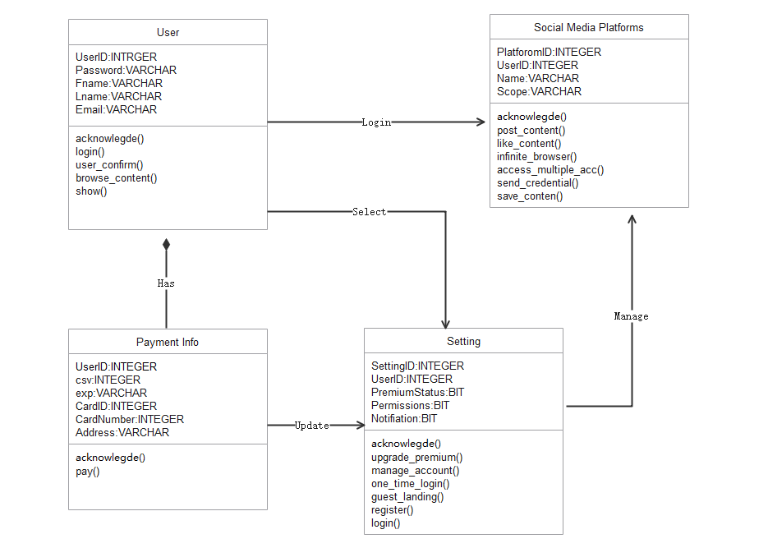
Class diagram of Stream Feeder (Team 5)

